Slide 1
CS550 - Introduction to Machine Learning
Automated Essay Grading System
By : Team Vectors
Mohit Sharma (11840730)
Vivek Singh (11841240)

Slide 2
Bag of words:
Bag of words is a method of feature extraction with text data.
A bag of words is a representation of text that describes the occurrence of words within a document.
We just keep track of word counts and disregard the grammatical details and the word order. It is called a “bag” of words because any information about the order or structure of words in the document is discarded.
The model is only concerned with whether known words occur in the document, not where in the document.
One of the biggest problems with text is that it is messy and unstructured, and machine learning algorithms prefer structured, well defined fixed-length inputs and by using the Bag-of-Words technique we can convert variable-length texts into a fixed-length vector.

Slide 3
Example of BoW:
Sentence 1: ”Welcome to Great Learning, Now start learning”
Sentence 2: “Learning is a good practice”
After data cleaning:
Sentence 1: ”welcome great learning now start learning”
Sentence 2: “learning good practice”

Slide 4
Create Model Vocabulary:
welcome, great, learning, now, start, good, practice.
Scoring method for each sentence:
Sentence 1 ➝ [ 1,1,2,1,1,0,0 ]
Sentence 2 ➝ [ 0,0,1,0,0,1,1 ]
In Machine learning datasets are tremendously large and can contain vocabulary of a few thousand or even millions of words. In practice, only a few words from the vocabulary, more preferably most frequent words are used to form the vector.

Slide 5
The BoW model is commonly used in methods of document classification, where the (frequency of) occurrence of each word is used as a feature for training a classifier.
Here in particular essay set each essay gets classified based on human graded score. This means that those essay whose BoW vector is similar to essays which have higher test score falls in their category.
Bi-gram and Tri-gram:
Sentence 1: “This is a good job. I will not miss it for anything”
Sentence 2: ”This is not good at all”

Slide 6
With BoW:
Vocabulary of 5 words:
good, job, miss, not, all
Sentence 1: [1,1,1,1,0]
Sentence 2: [1,0,0,1,1]
Here sentence 2 is negative and sentence 1 is positive but this is not clear in BoW representation. A Bi-gram is a two-word sequence of words like “good job”, “not good” and a tri-gram vocabulary contains “will not miss”, “not good at”, “it for anything”. With bi-gram and Tri-gram a certain level of ordering and structure of sentence is taken into consideration which helps to classify sentences in a more efficient way than BoW.

Slide 7
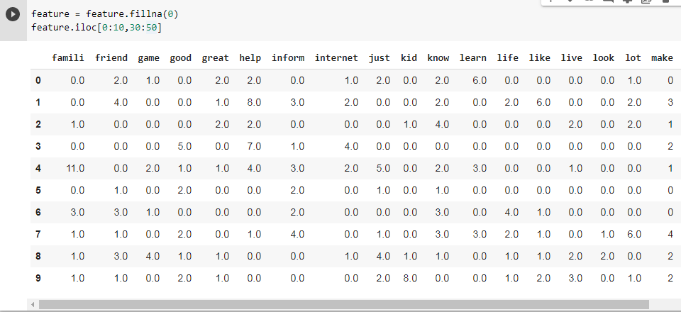
Bag of Words:

Slide 8
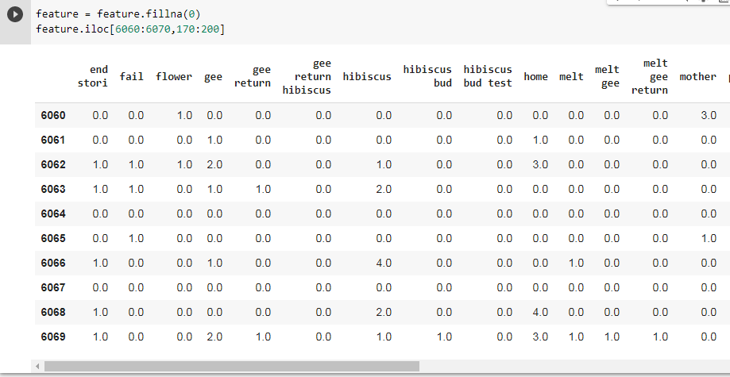
Bi-gram and Tri-gram:

Slide 9
Stemming :
Process of reducing inflected words to their word stem by generating the root form of the inflated words.
For eg.
am, are, is =>be
car, cars, car's, cars' car
The result of this mapping of text will be something like:
the boy's cars are different colors => the boy car be differ color

Slide 10
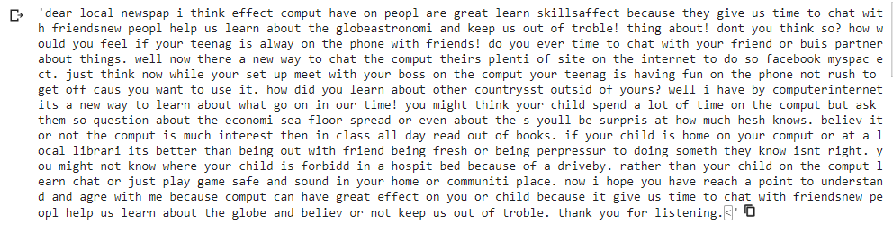
Essay after Stemming:

Slide 11
Lexical Diversity:
Measure of how many different/unique words are used in the essay.
The traditional lexical diversity measure is the ratio of different words (types) to the total number of words (tokens), the so-called type-token ratio, or TTR.

Slide 12
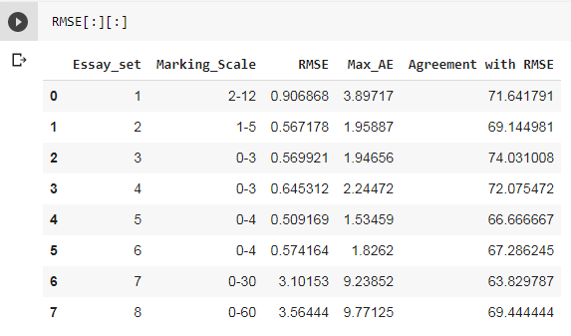
Results:
Improved Result

Slide 13
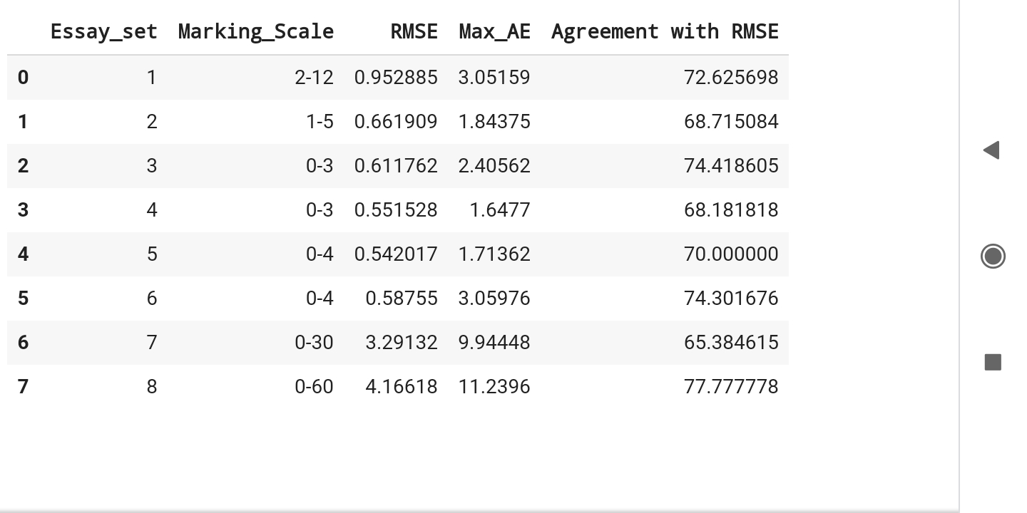
Results:
Old Result

Slide 14
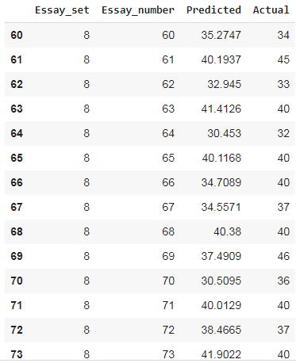
Set 8 predicted score:

Slide 15
Thank You

